Slide 1
Space and Measurement
Integration:
Area under graph
Volume of solid

Slide 2
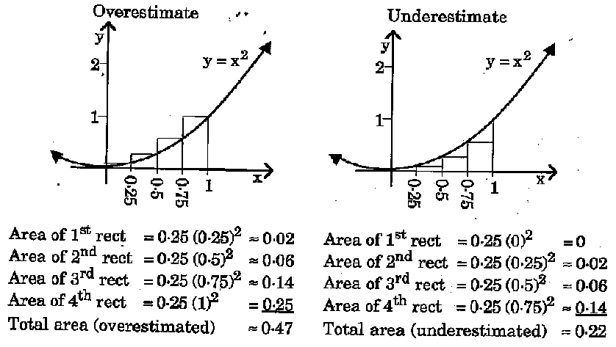
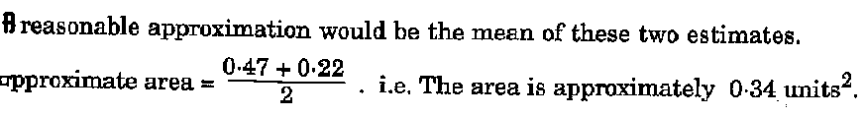
Integration and Area under graph

Slide 3
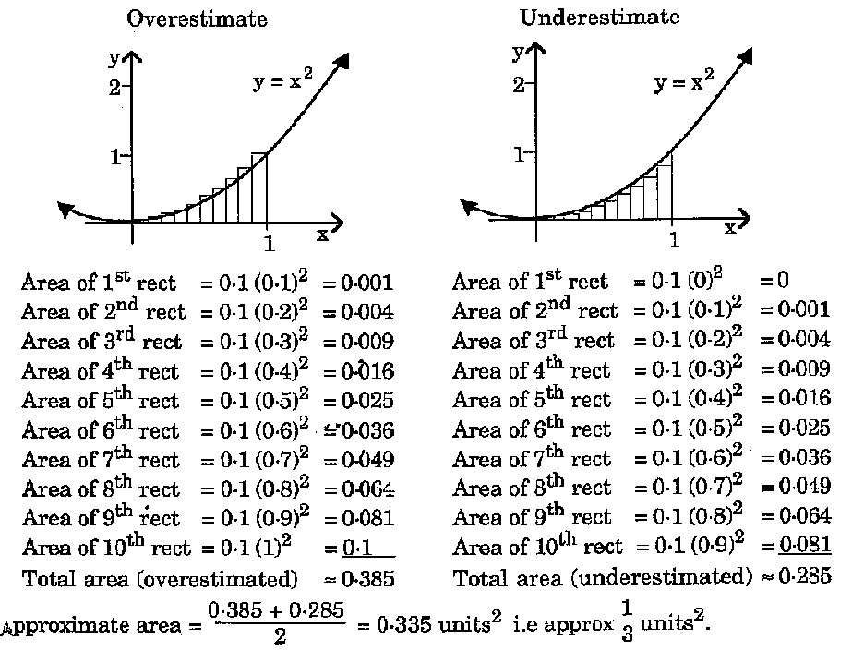
Integration and Area under graph

Slide 4
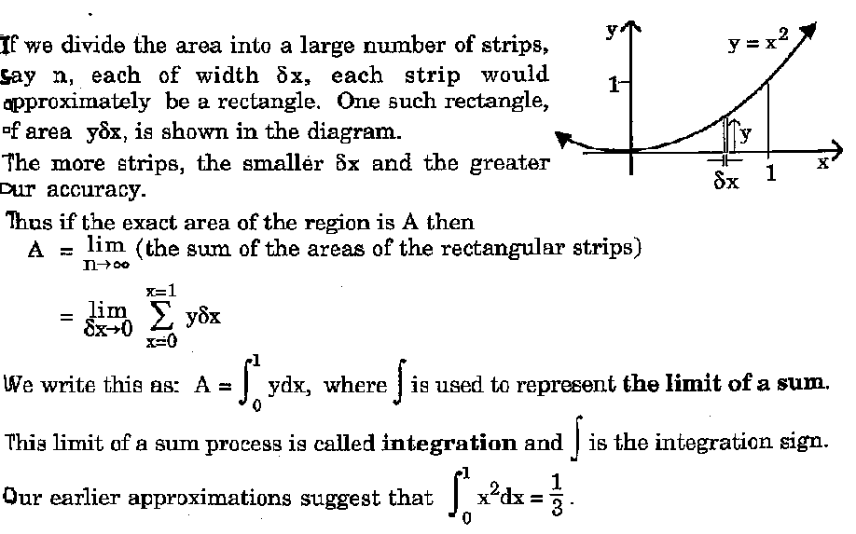
Integration and Area under graph

Slide 5
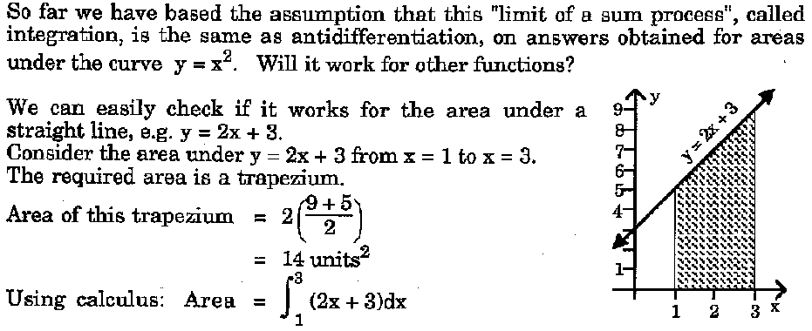
Integration and Area under graph

Slide 6
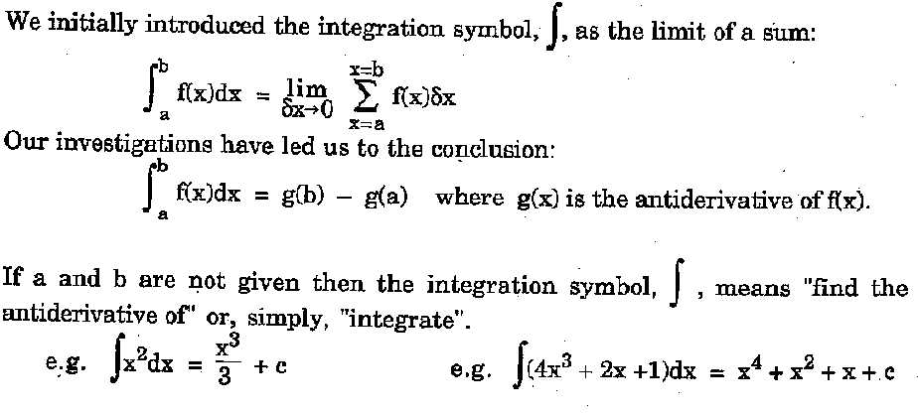
Integration and Area under graph

Slide 7
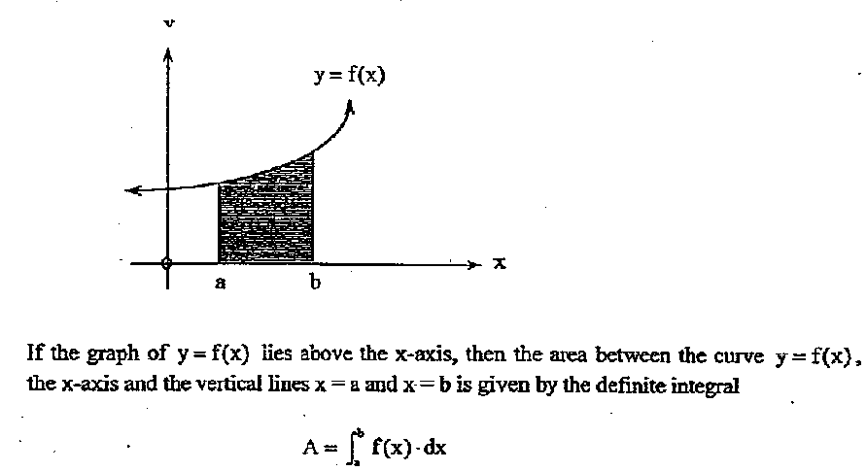
Area under the graph

Slide 8
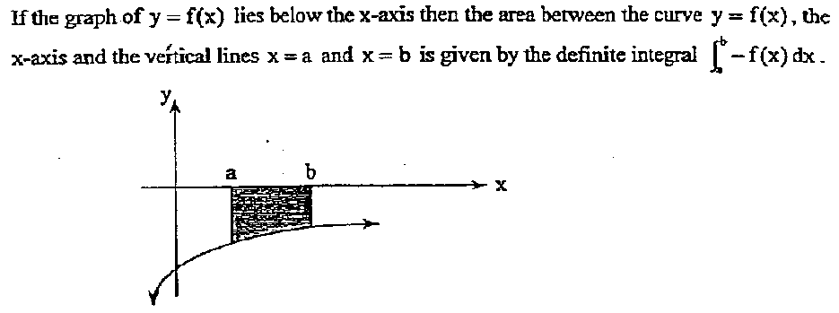
Area under the graph

Slide 9
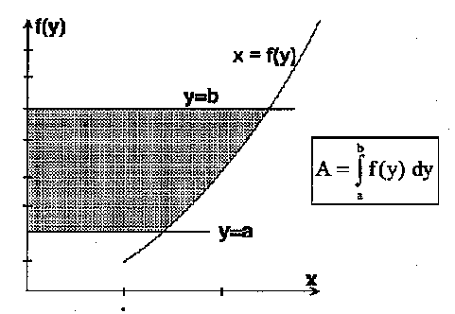
Area under the graph

Slide 10
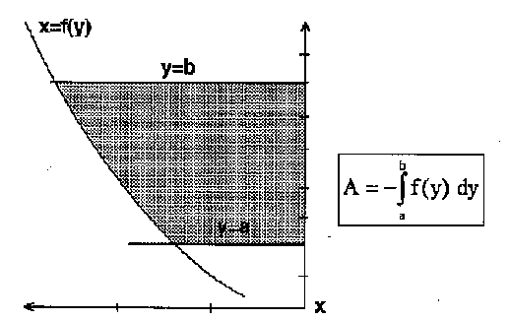
Area under the graph

Slide 11
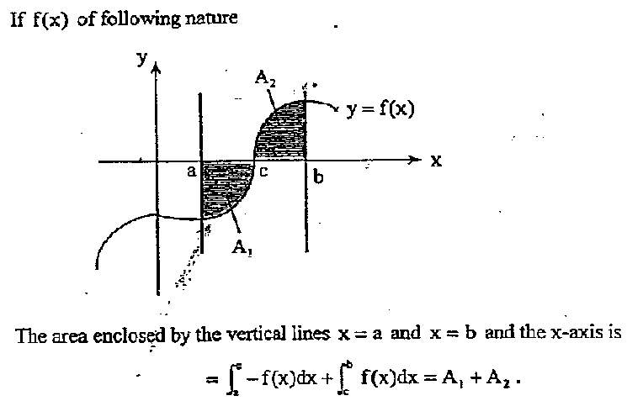
Area under the graph

Slide 12
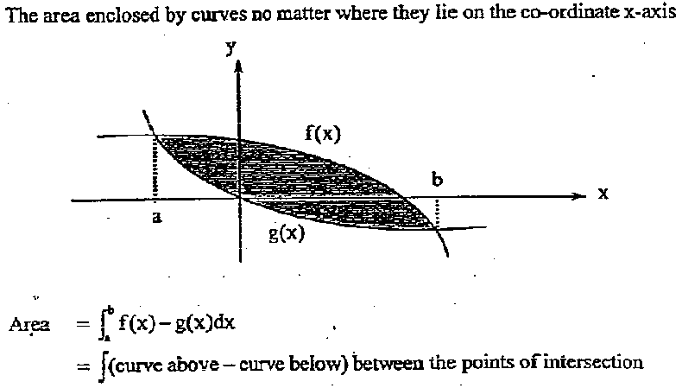
Area under the graph

Slide 13
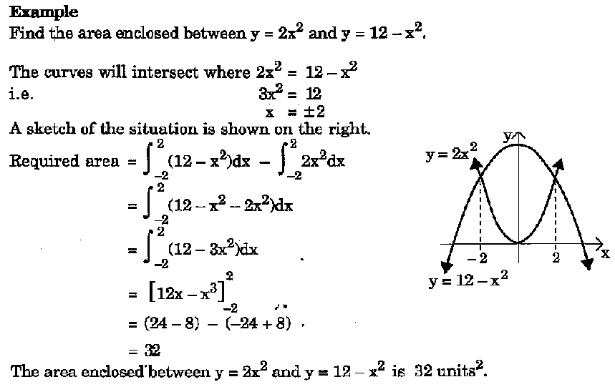
Example…

Slide 14
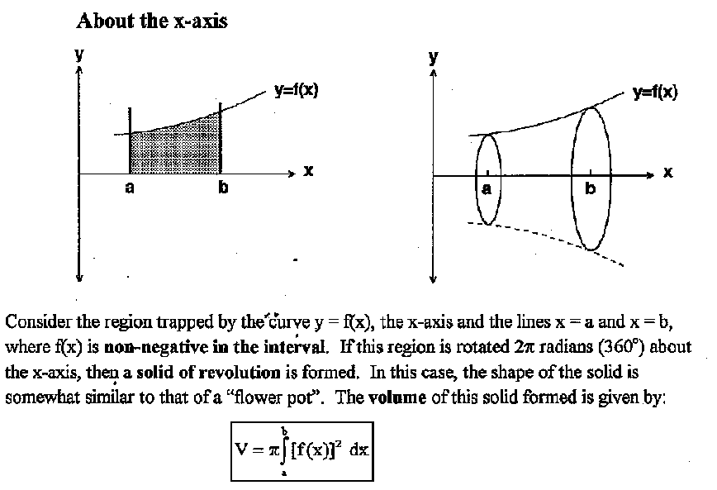
Volume of Revolution (solids)

Slide 15
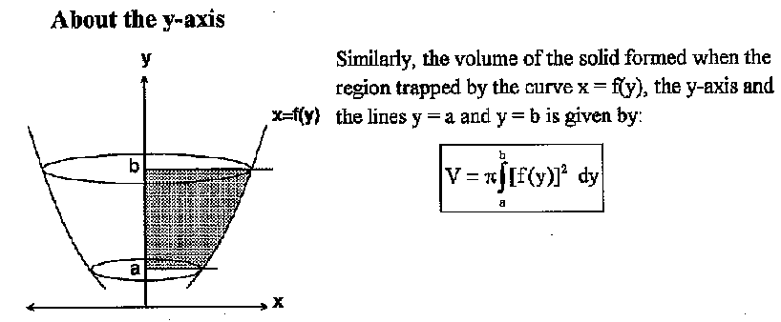
Volume of Revolution (solids)

Slide 16
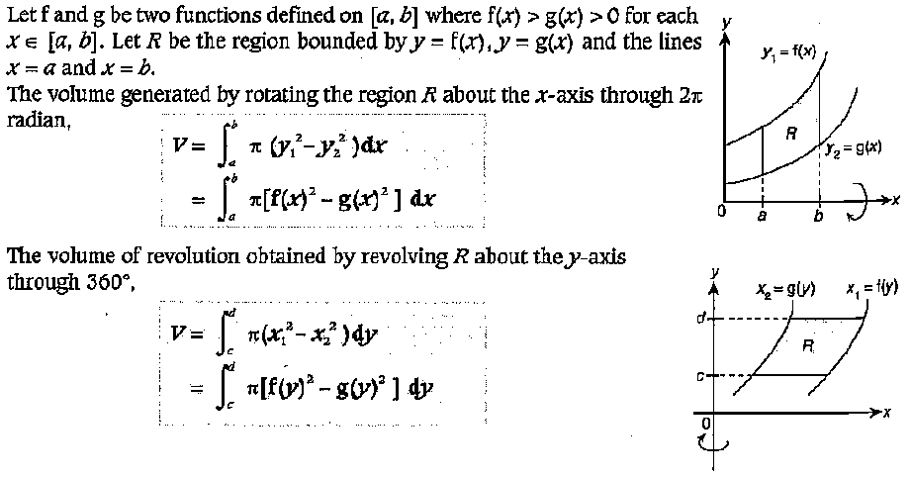
Volume of Revolution (solids)

Slide 17
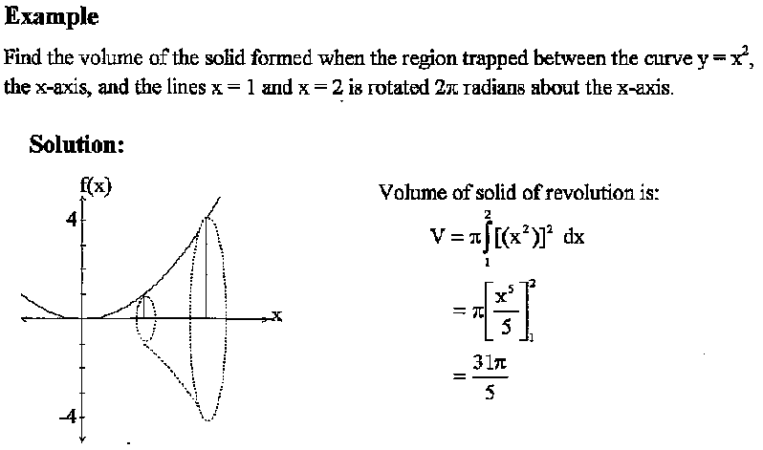
Volume of Revolution (solids)

Slide 18
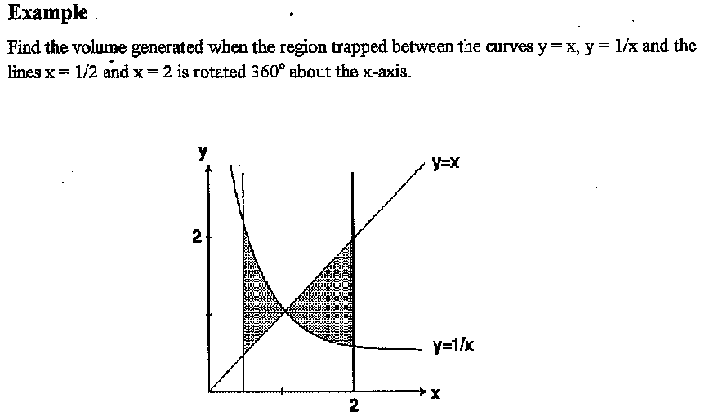
Volume of Revolution (solids)
solution

